Slide 1
Running Docker on HPC
Adrian Madej, Martyna Sokołowska

Slide 2


Used technologies
Apptainer - containerization technology.
Source of Scripts (SoS) - a computational environment that supports the development and execution of scripts in multiple languages within a single session.

Slide 3
Apptainer - Singularity container
What does it provide?
Operates without requiring administrator (root) privileges
Isolation and portability – all data contained in a single .sif file
Security – supports container encryption and cryptographic signing to ensure image integrity.
Integration with HPC systems
Support for GPUs and accelerators
What Docker is to Kubernetes, Singularity is to HPC.

Slide 4
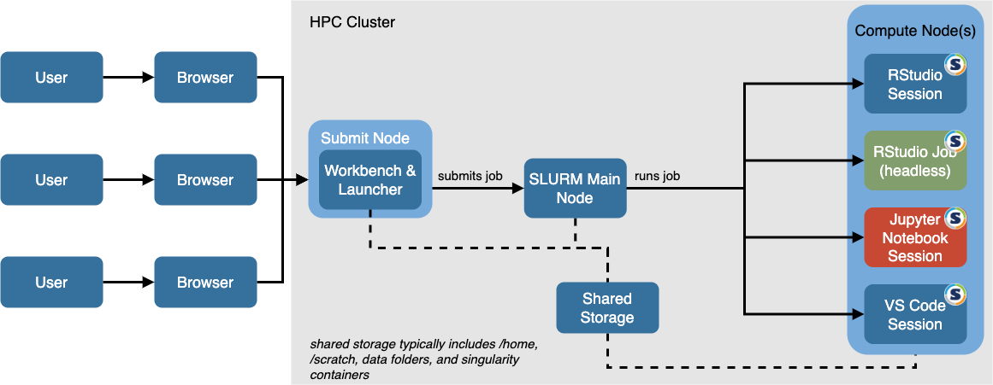
Integrating Apptainer into the SLURM Workflow

Slide 5
Apptainer - useful commands
cache - manage local cache
capability - manage Linux capabilities for users and groups
config - manage various Apptainer configuration (root user)
exec - run command within a container
instance - manage containers running as services
run - run user-defined default command within a container
shell - run shell within a container
test - run user-defined tests within a container
build - build Apptainer image
delete - delete image from library
pull - pull image from URI
push - upload image to the URI
sif - manipulate Singularity Image Format images

Slide 6
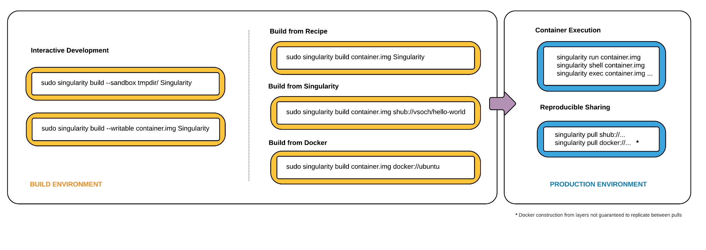
Apptainer – Singularity container

Slide 7

Apptainer vs Docker
 | Docker | Apptainer
Privileges Required | Requires root privileges | Runs from user space (no root required)
Image management | Layered image system (multiple files) | Single .sif file
Portability | Stored in registries (eg. Docker Hub) | .sif files are portable and easy to share
HPC integration | Limited, requires additional tools | Designed for HPC environments
GPU support | Via NVIDIA Container Toolkit (additional tool) | Good integration (eg. CUDA support)
Operating systems | Linux, Windows, macOS | Primarily Linux

Slide 8
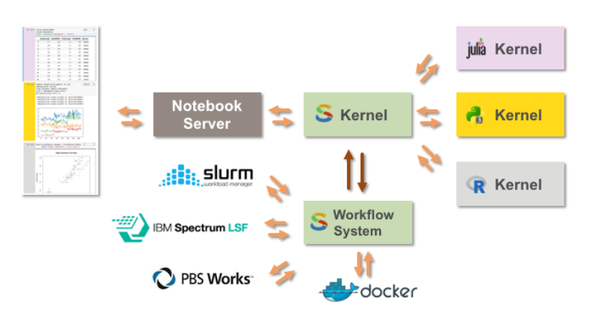
Script of Scripts

Slide 9
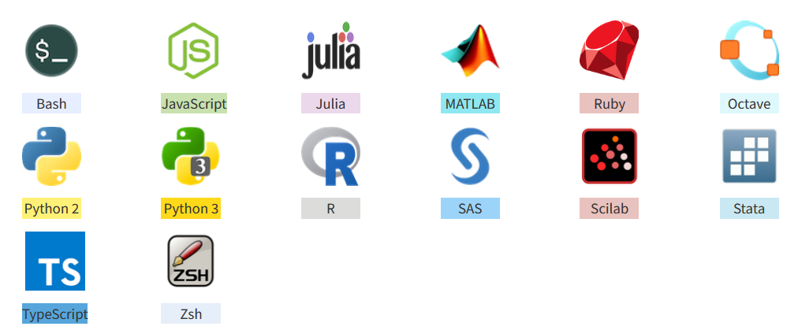
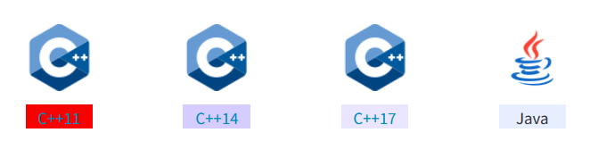
SoS - supported languages

Slide 10
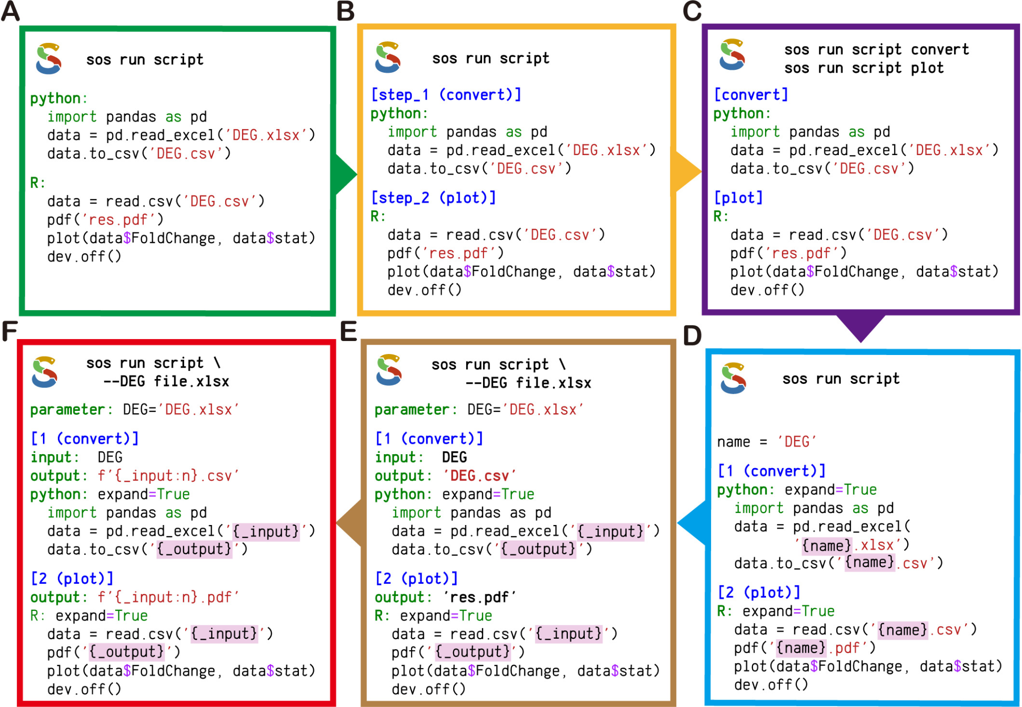
SoS - workflow system
Most workflow systems are complex and rigid. Sos is simple and flexible
Great for everyday data analysis, not just big projects

Slide 11
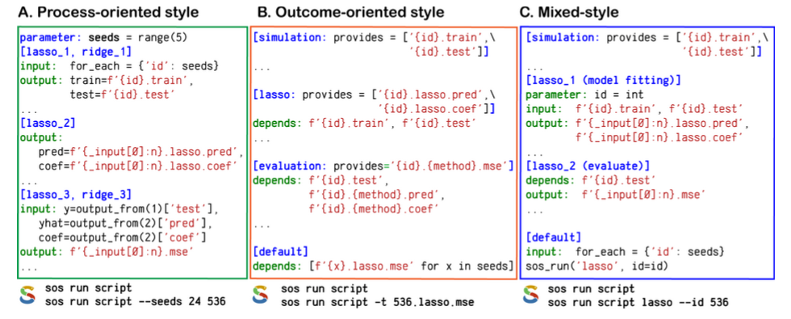
SoS - mixed style workflow
Supports step-by-step workflow
Supports makefile-style workflow
Supports mixed workflow

Slide 12
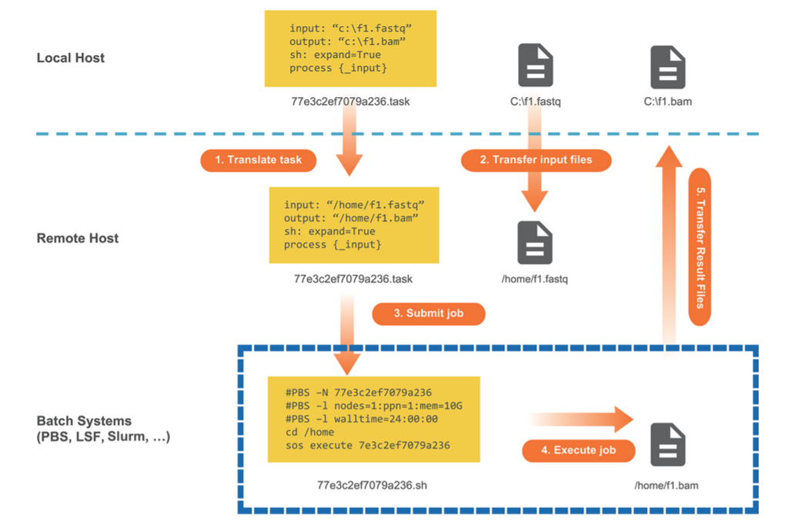
SoS - Remote Execution
Large workflows often require remote computational resources, which usually involve complex setup
SoS provides a remote execution model that allows sending tasks to remote servers and clusters directly from the local machine.
Enables reproducible and scalable data analysis without extra hassle

Slide 13
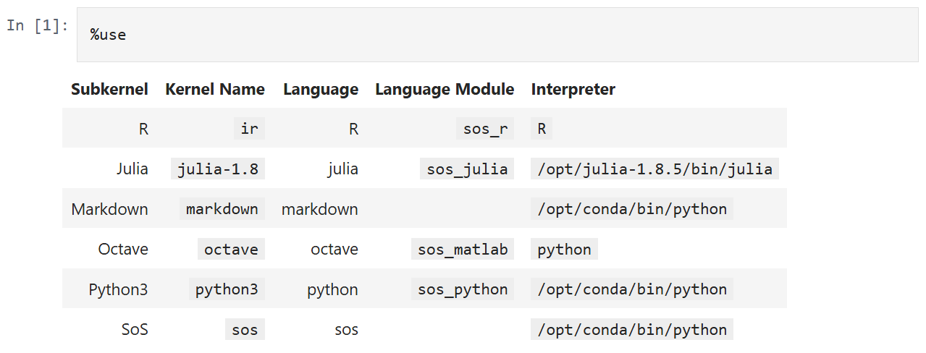
Practical usage of Script of Scripts

Slide 14


Used Dataset
We used the Palmer Penguins dataset, which includes:
Collected from islands in the Palmer Archipelago (Antarctica)
Contains 3 species: Adelie, Gentoo, Chinstrap
Features: bill size, flipper length, body mass, sex, year
Used for: classification, clustering, and visualization

Slide 15
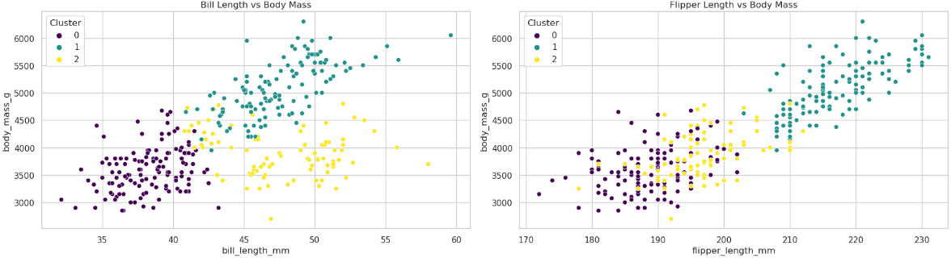
Notebook
Notebook link

Slide 16
How to reproduce our example?
Run Docker Image:
To access a worker node, request a session using srun
srun -p plgrid-now --time 1:30:00 --pty /bin/bash -l
Once the session is started, verify that Apptainer is available
apptainer version
Create a directory for your project and upload files from local machine
mkdir lsc-proj && cd lsc-proj
scp pengiuns.csv notebook.ipynb NICK_NAME@ares.cyfronet.pl:~/lsc-proj/
Download the Script of Scripts container image
apptainer pull docker://vatlab/sos-notebook
Run the SoS container image:
apptainer run sos-notebook_latest.sif

Slide 17
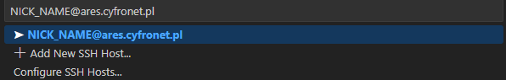
How to reproduce our example?
Run Visual Studio Code:
Start Visual Studio Code and install the extension Remote - SSH from Microsoft.
Start a remote SSH connection to Ares/Athena (you can invoke the command palette using Ctrl+Shift+P and search for Remote-SSH: Connect to Host).
Open the lsc-proj/notebook.ipynb file.

Slide 18
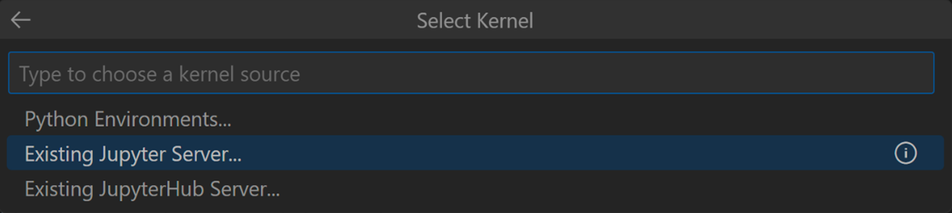
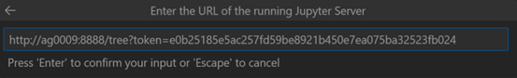
How to reproduce our example?
Run Visual Studio Code:
Connect to the Jupyter server started on the worker node.
First, choose Existing Jupyter Server.
Then paste the Jupyter connection URL printed earlier. For example:

Slide 19
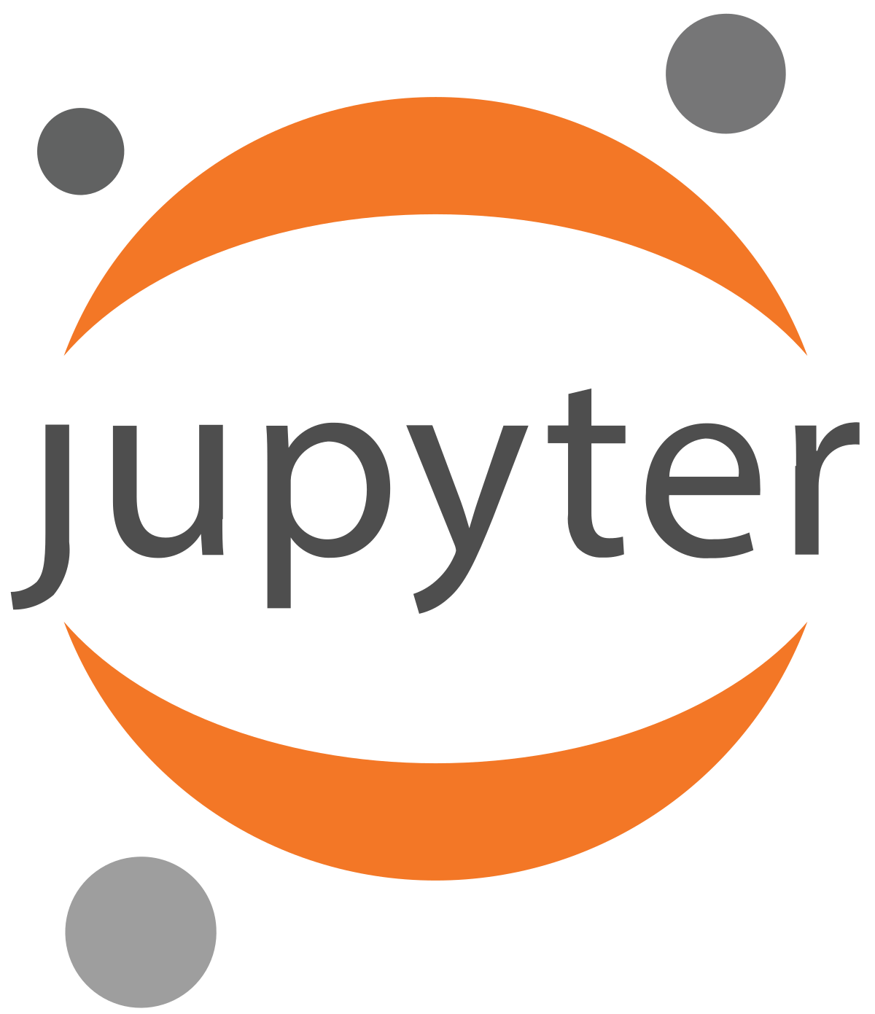

How to reproduce our example?
Run Viusal Studio Code:
Choose the SoS kernel from the available list
Full instructions available here: link

Slide 20
Apptainer - summary
✅ Advantages
Rootless execution – no admin rights required
Secure isolation – safe for multi-user HPC clusters
Seamless SLURM integration – works well with job schedulers
Portable image format (.sif) – easy to share and move
Direct access to host resources – unlike Docker’s containerization
🔧 Use Cases
Mainly used on HPC
❌ Limitations
Not suitable for microservices or orchestration (e.g., Kubernetes)
Smaller community & limited technical support
No native network isolation

Slide 21
Script of scripts - summary
✅ Advantages
Multi-language support in a single Jupyter Notebook
Great for reproducible workflows - clear separation of steps, parameters, and outputs
Visual workflow organization - use markdown, headers, and tags to structure notebooks
🔧 Use Cases
Data science and bioinformatics pipelines
Prototyping workflows using different tools
❌ Limitations
Limited GUI kernel switching in VS Code
Requires SoS kernel installation
Learning curve for cell tagging and kernel linking

Slide 22
Thank you
Adrian Madej, Martyna Sokołowska

Slide 23
Apptainer - pros and cons
Pros:
No Root Required at Runtime
Designed for HPC
Built-in GPU Support
Strong Security Model - No long-running daemon
Good for reproducibility
Can Use Docker Images
Cons:
Limited Ecosystem & Community
Not Meant for Microservices or Orchestration
Limited Networking Features
Primarily Linux-only
Less Suitable for CI/CD
Complexity in Building Images

